Slide 1
Special Commission on Local and Regional Public Health
Blueprint for public health excellence
Recommendations for Improved Effectiveness and Efficiency
of Local Public Health Protections
Massachusetts Association of Health Boards Certificate Program
November 2, 2019 - Marlborough
Cheryl Sbarra, J.D.,
Director of Policy and Law, Massachusetts Association of Health Boards
Erica Piedade, Director of Local Public Health Initiatives
Office of Local and Regional Public Health
Notes:
Thank you for the opportunity to provide an overview of the findings and recommendations of the Special Commission on Local and Regional Public Health

Slide 2
Special Commission on Local and Regional Public Health
“…assess the effectiveness and efficiency of municipal and regional public health systems and … make recommendations regarding how to strengthen the delivery of public health services and preventive measures.”
- Chapter 3 of the Resolves of 2016
Notes:
The Special Commission on Local and Regional Public Health completed its work with the approval of its final report – Blueprint for Public Health Excellence: Recommendations for Improved Effectiveness and Efficiency of Local Public Health Protections at its June 2019 meeting. The Commission was established by Chapter 3of the Acts of 2016 to assess the effectiveness and efficiency of municipal and regional public health systems and … make recommendations regarding how to strengthen the delivery of public health services and preventive measures.

Slide 3
Why Special Commission?
Inconsistency across communities
Small towns struggle
Variability in board and staff credentials
Limited ability to meet accreditation standards.
Shared services proceeding slowly
From Strengthening the Local and Regional Public Health System.
Massachusetts Public Health Association (2016)
Notes:
The Commission was created in response to documented areas of the local public health system that need improvement. There are disparities in the capacity of local public health authorities to provide legally mandated services. Where you live often determines whether you have access to a basic level of public health services. In the absence of credentials for the local public health workforce (board of health members and staff), there are disparities in the capabilities of the workforce across communities. Few communities have the capacity to apply for public health accreditation let alone meet the rigorous standards set by the Public Health Accreditation Board. Despite efforts over the past decade to promote shared service arrangements among communities, many communities have been slow to embrace the benefits.

Slide 4
Commission Members
Executive branch agencies
Legislators
Appointments by the Governor
Named organizations
Notes:
The Commission included 4 executive branch representatives (DPH- with Commissioner Bharel as chair, the Department of Environmental Protection, Department of Agricultural Resources, and Executive Office of Administration and Finance), 4 legislators, 8 appointments by the Governor, and representatives of 9 named organizations including public health trade associations, the Massachusetts Municipal Association, and Massachusetts Taxpayers Foundation.

Slide 5
Commission Charge
Capacity of local public health system
Existing resources for local health
Workforce credentials
Capacity of the Office of Local and Regional Health
Regional collaboration and various models of service delivery
Progress towards achieving regionalization advisory commission recommendations
Report of findings and recommendations
Notes:
The key elements of the Commission’s charge are listed here. The Commission was charged with assessing
the current capacity of the local public health system to meet national standards and to carry out their statutory powers and duties
Resources available for the local public health system
Credentials of the local public health workforce
Capacity of the Office of Local and Regional Health
Approaches to shared public health services
Progress towards achieving the 2009 public health recommendations of the Regional Advisory Commission
Submit a report of its findings and recommendations

Slide 6
“Blueprint for Public Health Excellence” Report
The report documents the Commission’s findings and makes recommendations for strengthening local public health services and protections across the Commonwealth.
Notes:
Report was posted on OLRH-SCLRPH web page
E-mail with link to report was sent by OLRH and entities represented on the Commission
OLRH updating its web pages to align with Commission recommendations
MHOA planning a session on the findings and recommendations at its annual conference in November
MPHA and other partners distributed the report to members of the legislature

Slide 7
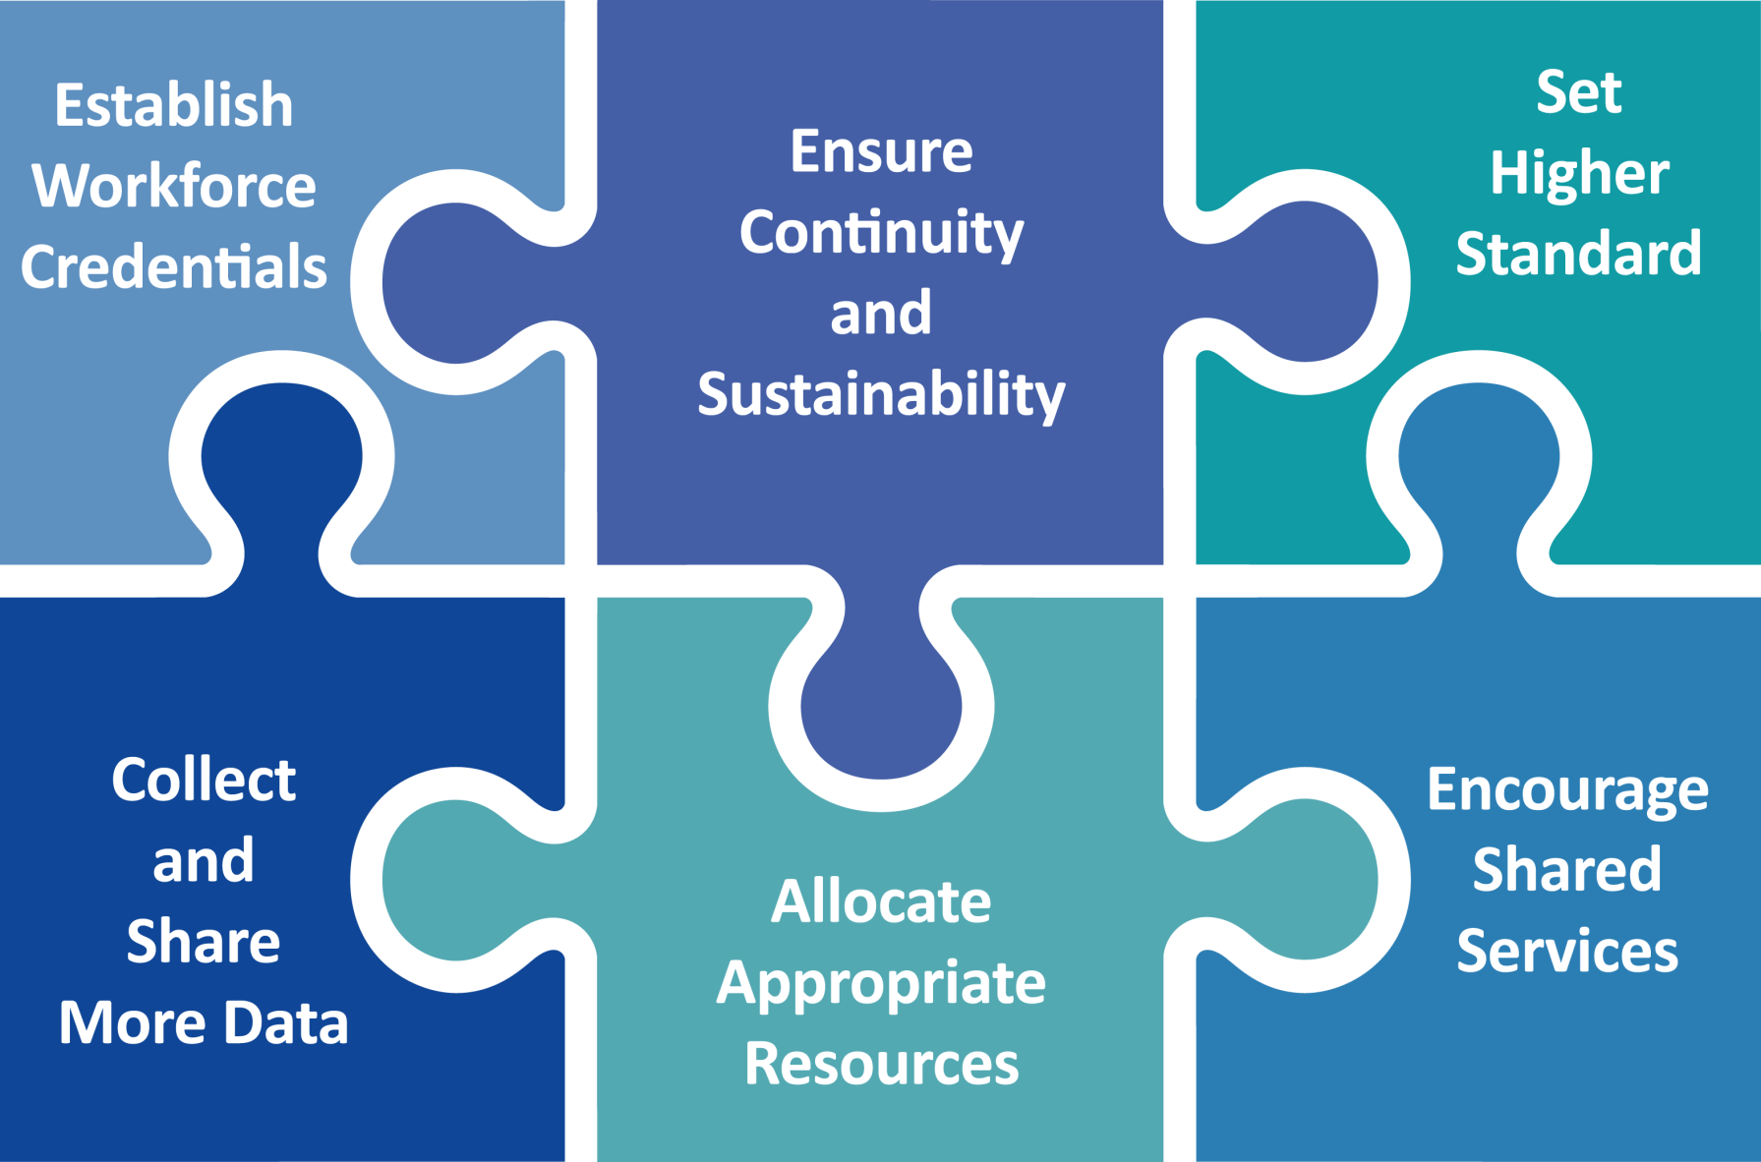
Interlocking Recommendations
Notes:
The Commission made recommendations in six areas.
While each of the individual measures recommended in the report is beneficial by itself, they are intended to be adopted as an interlocking set, reinforcing and magnifying each other.

Slide 8
Public Health Standards
Commission Finding
Many Massachusetts cities and towns are unable to meet statutory requirements and even more lack the capacity to meet rigorous national public health standards.
Commission Recommendation
Elevate the standards for and improve the performance of local public health departments.
Notes:
The Commission found that the Massachusetts local public health system was not meeting national public health standards. These standards have evolved over the past three decades – beginning with the ten essential public health services promoted by the U.S. Centers for Disease Control and Prevention in the 1990s to the rigorous accreditation standards set by the Public Health Accreditation Board. The Commission also found that many Massachusetts cities and towns struggle to carry out statutory duties and responsibilities.
It recommended a two-step approach – bring municipalities to the capacity to meet statutory obligations and move the Commonwealth toward a system in which all cities and twons meet national standards.

Slide 9
Cross-Jurisdictional Sharing
Commission Finding
Massachusetts has more local public health jurisdictions than any other state (351)—one for each city and town—and cross-jurisdictional sharing of services is limited despite evidence that it improves effectiveness and efficiency.
Commission Recommendation
Increase the number and scope of comprehensive public health districts, formal shared services agreements, and other arrangements for sharing public health services.
Notes:
The federally-funded Public Health District Incentive Grant program in 2009 created 5 new public health cross-jurisdictional sharing arrangements but their has been little progress since then in forming new shared services arrangements. Massachusetts has 351 local public health jurisdictions – many more than any other state – and only about 20% of those cities and towns are involved in a formal shared services arrangement.

Slide 10
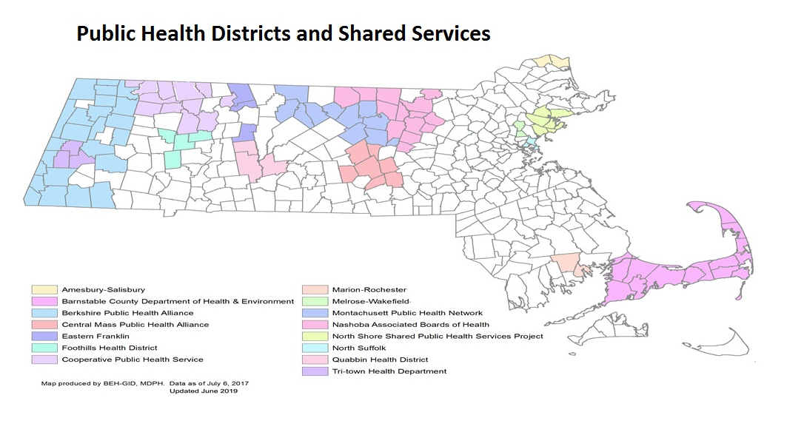
Public Health Districts for Shared Services
Notes:
This map shows municipalities that are in shared services arrangements or public health districts. Each of the 15 shaded areas represent arrangements in which there is shared governance. I call your attention to the cities and town that are not shaded – they represent nearly 70 percent of cities and towns and 80 percent of the population.

Slide 11
Data Reporting and Analysis
Commission Finding
Limited capacity to measure local public health system performance and to use local data to plan public health improvements
Commission Recommendation
Create a standardized, integrated, and unified public health reporting system
Strengthen DPH and local public health capacity to collect, analyze, and share data.
Notes:
Data to measure local public health system performance is limited. While other states have a formal process by which local public health jurisdictions report on a variety of system measure to the state department of public health, Massachusetts has a patchwork system of categorical reporting requirements.
The Commission recommended taking steps to improve the data collection system to approach systems in place in other states.

Slide 12
Workforce Credentials
Commission Finding
The Massachusetts local public health system does not adequately support its workforce with standards and credentials that align with the capacity to meet current mandates and future standards.
Commission Recommendation
Set education and training standards for local public health workforce and expand access to professional development by implementing local public health workforce credentialing standards.
Notes:
The Commission found that the lack of workforce credentials contributes to the variability in the capacity of local public health authorities to provide public health services and protections.
The Commission recommended a detailed set of standards for the local public health workforce that is on pages 61 and 62 of the report.

Slide 13
Resources to Meet System Needs
Commission Finding
Funding for local public health is inconsistent and inequitable in its ability to meet the current mandates and the needs of a 21st century system
Commission Recommendation
Commit appropriate resources to the local public health system changes proposed by the commission.
Notes:
The depth and breadth of local public health protections, like many other municipal services that are supported largely by local tax revenue, varies from municipality to municipality.
The Commission recognized that investing more funding to achieve equity in system capacity across municipalities is not the solution. The appropriate use of existing resources is a necessary step.

Slide 14
Continuity and Sustainability
Commission Finding
The Massachusetts local public health system depends on the continuing engagement of the stakeholders who have laid out an actionable path to effectiveness and efficiency.
Commission Recommendation
Continue to engage a wide range of stakeholders to provide ongoing support for the recommendations for systems improvement.
Give DPH the infrastructure and authority to support the recommendations.
Notes:
The Commission believed that a successor entity is necessary to monitor and inform progress on is recommendations. It met its obligation in submitting its final report.

Slide 15
Next Step: Advisory Committee
Local and Regional Public Health Advisory Committee
Request for Information process to gather input on membership and structure
Notice of Opportunity to solicit applications to serve on advisory committee
Working groups on shared services and workforce credentials
CLPH priorities for DPH administrative recommendations
Notes:
An important first step in the advancing the Commission’s recommendations is the creation of an advisory committee to monitor and inform implementation of the recommendations. Working groups will focus on priority recommendations – shared services, workforce credentials, and DPH/DEP administrative actions. The administrative actions are suggestions for DPH and DEP to change some policies and procedures to improve efficiency. For example, allowing public health districts to submit a single report rather than several individual ones.
The advisory committee will meet less frequently than the Commission

Slide 16
Next Step: Cross-Jurisdictional Sharing
Municipal Shared Public Health Services Grant Program
Funds in FY2020 DPH budget for shared public health services
Proposals due yesterday
Shared services grants to municipalities are expected to begin in January 2020.
Notes:
The Commission recommended the formation of new formal arrangements for sharing services and the expansion of existing public health districts and shared services. The expansions would allow the inclusion of more municipalities to an existing district and/or providing a more comprehensive set of services and protections.
As a result of the Commission’s work, the FY2020 budget includes $500,000 for shared public services in the DPH administrative account. We expect to release an RFR this month for upt to 3 new shared services arrangements and the expansion of up to 3 existing public health districts.
We expect the shared services programs to begin on January 1st.

Slide 17
Next Step: Workforce Credentials
Local Public Health Workforce Standards
Credentials requirements
Education
Certifications (e.g., Certified Health Officer, Registered Sanitarian)
Training requirements (e.g., Foundations of Local Public Health Practice)
Notes:
The Commission recommended the creation of standards for the local public health workforce.
These standards included
a level of academic preparation consistent with the position held (for example, public health director, health agent, health inspector, public health nurse)
Certifications such as certified health officer and registered sanitarian
Training requirements such as the Foundations of Local Public Health Practice course offered by the DPH-funded Local Public Health Institute at the BU School of Public Health.
In its deliberations, the Commission was informed of current challenges with the boards associated with the certified health officers and registered sanitarians. These challenges include appointments to fill vacancies and infrequent meetings. A working group will be convened to explore solutions – including moving the boards to DPH from the Division of Professional Licensure at the Executive Office of Consumer Affairs as an administrative function.

Slide 18
Next Step: Data Reporting and Analysis
Environmental Scan of Approaches to Inspectional Reports
Coalition for Local Public Health review of approaches to electronic inspection reports in Massachusetts and other states

Slide 19
Thank you!
Questions and comments
Notes:
The Commission provided a blueprint to move the Massachusetts local public health system to one in which every resident of the Commonwealth receives the same set of local public health services and protections. Thank you for the opportunity to provide this overview.
I welcome your questions and comments.

