Slide 1
Integrating Local Knowledge into your Disaster Planning: a New APP
Massachusetts Association of Health Boards Annual Certificate Program
Taunton, MA
November 16, 2019
Rachael Piltch-Loeb, Nigel Harriman
Emergency Preparedness, Research, Evaluation & Practice Program
www.hsph.harvard.edu/preparedness

Slide 2
Acknowledgements
This project was supported by Broad Agency Announcement 2016-N-17770 from the U.S. Centers for Disease Control and Prevention. The contents are solely the responsibility of the authors and do not necessarily reflect the views of the CDC.

Slide 3
Learning Objectives
Understand the importance of supporting vulnerable populations before, during and after a disaster.
Understand the potential role of local knowledge in disaster preparedness.
Describe communications strategies using local knowledge to engage and support vulnerable populations in disasters.

Slide 4
Plan for Community Needs in a Disaster…
Evacuation guidance…”How do I leave?”
Shelter support …”Where do I go?”
Basic physical needs: …”I’m hungry and thirsty!”
Other needs: …”I need fuel for my generator, batteries for my flashlight, refills for my prescription.”
Communications …”How can I contact my family?”
And…
Information! …”What is happening?”

Slide 5
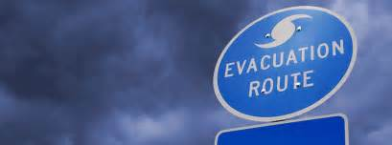
Educating Your Community Before a Disaster…
Disaster supplies…”Get a flashlight and batteries”
Disaster Shelters…”What a shelter offers”
Basic physical needs: …”Stock up on canned food”
Communications …”Get a battery-operated radio”
Other needs: …”Try to refill prescriptions before a storm”

Slide 6
What can make groups in your community more vulnerable?
Potential determinants (root causes) of vulnerability:
Economic disadvantage: e.g. homeless
Language and literacy: limited English comprehension or non-English speaking
Medical issues and disability: sensory impairment (blind, deaf) cognitive disorders, mobility limitation, suffering from addiction
Isolation: geographically or culturally
Age: Frail elderly
Notes:
Vulnerabilities are defined by function not by determinant. So if you describe the categories you use the ones on the right based on the type of function that requires assistance rather than the potential cause of the vulnerability. In our study we used the cause to find the vulnerabilities but not to define the categories.

Slide 7
Disaster Planning for Vulnerable Populations

Slide 8
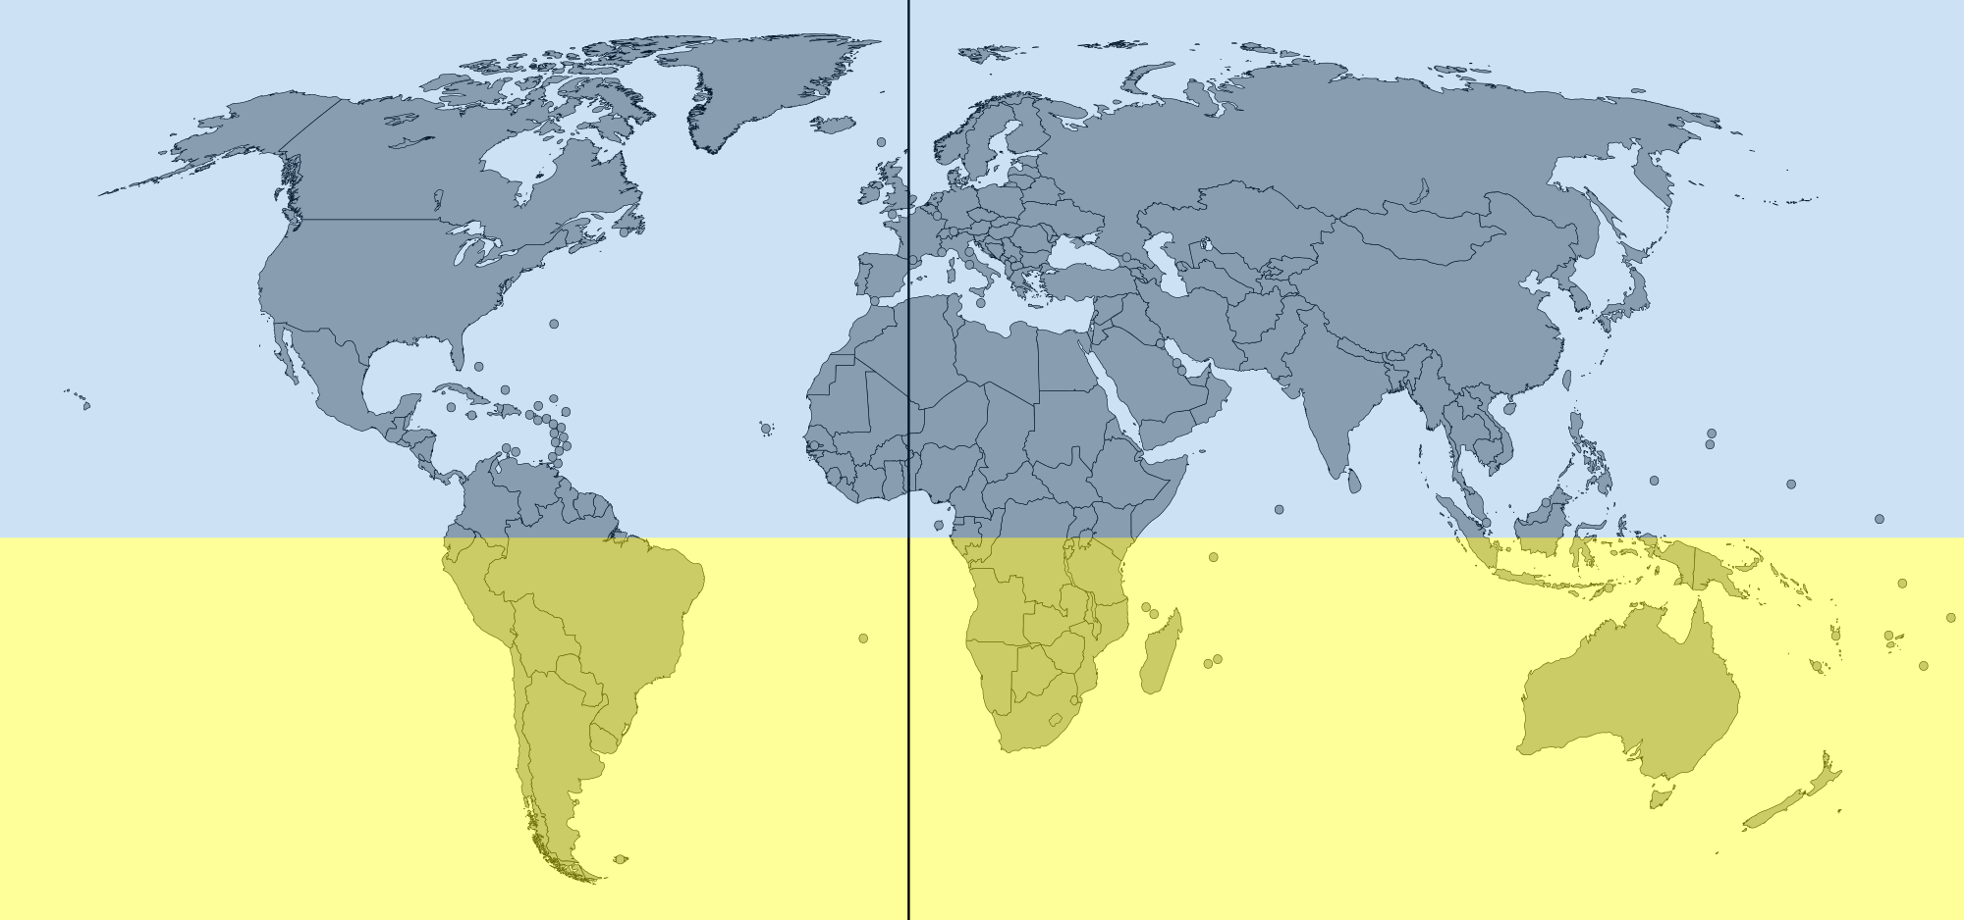
Module 1
Simulation
Southern Hemisphere flu activity, typically occurring between April and September of each year, has been robust since early June

Slide 9
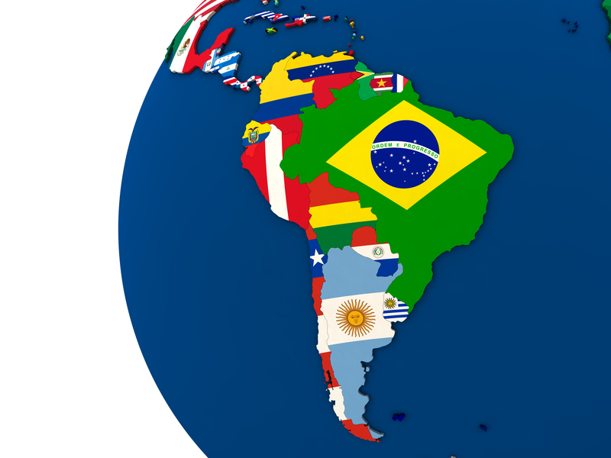
Module 1
Simulation
WHO Influenza Update of Southern Hemisphere flu data for the period of May 15- June 25:
Widespread ILI activity has been noted across many South American countries
Activity is predominantly due to H1N1 Influenza A type

Slide 10
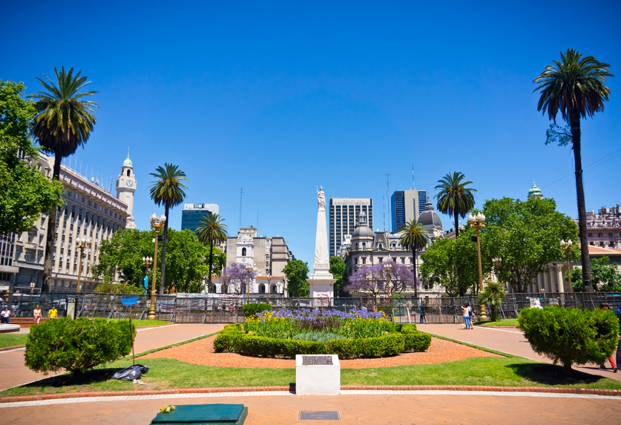
Module 1
Simulation
Attack rate and number of hospitalizations due to respiratory illness vary across affected countries, but appear to be notably higher than normal
Spike observed in patient deaths attributable to respiratory illness: 35 deaths in Buenos Aires alone
Concerns about the outbreak of severe respiratory illness associated with influenza have caught the attention of global health experts and media outlets have picked the news.

Slide 11
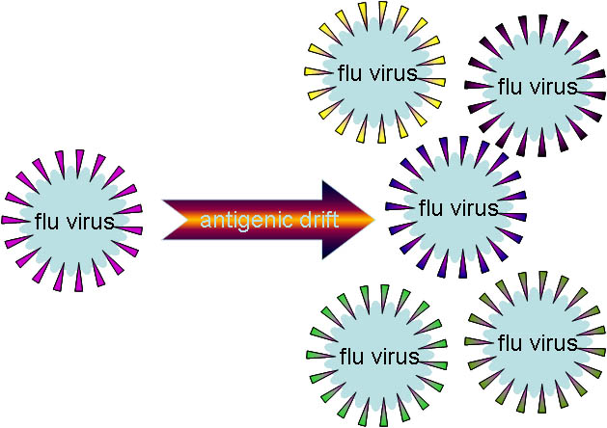
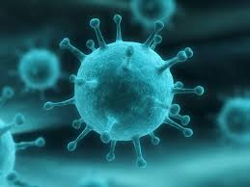
Module 1
Simulation
Virologists have detected a genetic variant in the predominant circulating strain of Southern Hemisphere H1N1 Influenza A as compared to the 2009 H1N1 strain that was
These changes represent a major antigenic drift of the Influenza A H1N1 virus

Slide 12
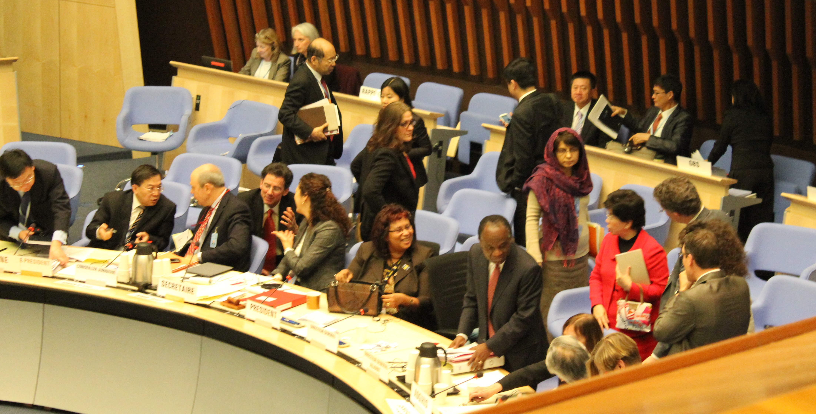
Module 1
Simulation
The WHO convenes an emergency meeting with key stakeholders
Based on flu activity in the Southern Hemisphere, new recommendation issued that the previously selected composition for the Northern Hemisphere seasonal flu vaccine should be modified

Slide 13
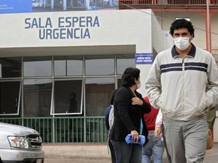
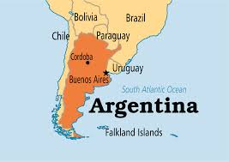
Module 1
Simulation
News of 2018 H1N1, or “Argentinian Flu”, as it is now popularly known, is receiving even more frequent coverage in media outlets across the globe

Slide 14
Module 1
Simulation
First case in United States!
First case of Influenza is reported in Florida in a 17 year old male who returned from Argentina where he went to visit his family
The student has been hospitalized with severe respiratory syndrome
Lab has confirmed the virus strain as Argentinian strain
National and international TV is covering the news.

Slide 15
Module 1
Simulation
You have been asked to review your emergency preparedness plans with an emphasis on:
Communications with vulnerable populations
Protecting yourself: hand hygiene
Flu symptoms
Where to go for flu test
Treatment
Vaccine status
Potential for school closures and cancellation of community events
Resources for additional information
source: NOAA
Notes:
Update red text as we near the exercise date

Slide 16
Module 1
Discussion
What is your plan to communicate with vulnerable populations about the pandemic flu?
source: NOAA
Notes:
Update red text as we near the exercise date

Slide 17
Module 2
Local Knowledge Presentation
WHAT IS ‘LOCAL KNOWLEDGE’?
Values, attitudes and beliefs
Social cohesion strategies
Communications capability
And...
Rarely recorded…
May be invisible to outsiders…

Slide 18
Examples of ‘LOCAL KNOWLEDGE’ related to emergencies..
Module 2
Local Knowledge Presentation
Communications:
Amateur radio
Less well-known community TV and radio stations
Where people informally meet to exchange information such as cafés or sports events
Trusted messengers
Translators
Non-Red Cross Disaster Shelters
Basement of a church, martial arts studio
Other Volunteer Groups

Slide 19
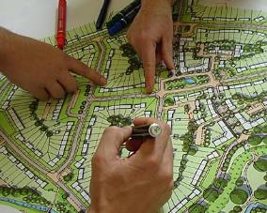
Project Overview: the HELPAPP App
Module 2
Local Knowledge Presentation
Local knowledge data entry
Local knowledge data
Public health disaster planners use data!

Slide 20
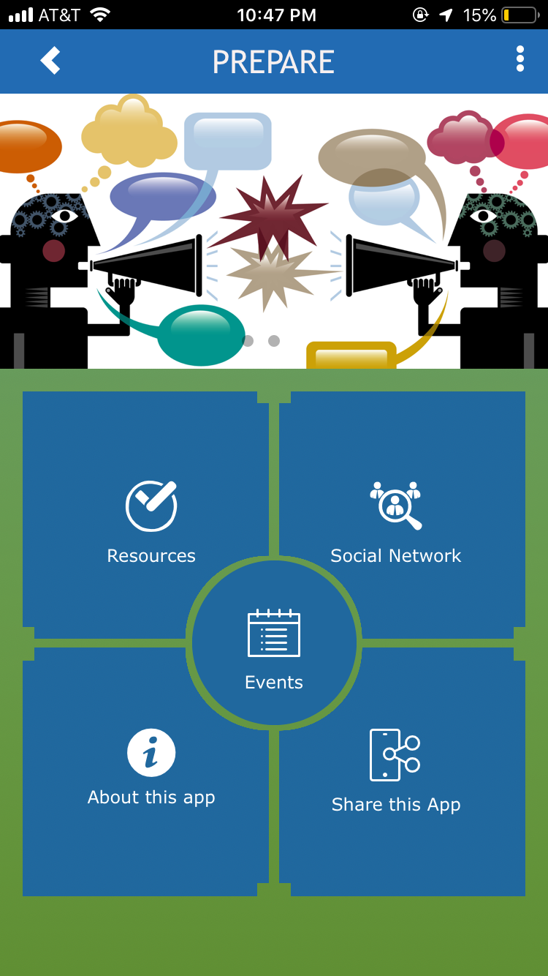
APP LIVE SIMULATION
Module 2
Local Knowledge Presentation

Slide 21
Module 3
Disaster Planning with the App
Please review your communication plans with an emphasis on communicating with vulnerable populations...using the app data.
Local Knowledge
source: NOAA
Notes:
Update red text as we near the exercise date

Slide 22
Module 3
Discussion
How could you integrate the local knowledge app data into your plans to communicate with vulnerable populations?
What would you do differently in your planning?
Protecting yourself: hand hygiene
Flu symptoms
Where to go for flu test
Treatment
Vaccine status
Potential for school closures and cancellation of community events
Resources for additional information
source: NOAA
Notes:
Update red text as we near the exercise date

Slide 23
Links to Resources
Harvard School of Public Health, Preparedness and Emergency Response Learning Center http://www.hsph.harvard.edu/hperlc/
CDC Emergency Preparedness and Response http://emergency.cdc.gov/
Johns Hopkins Center for Public Health Preparedness, Risk Communication Strategies for Public Health Preparedness http://www.jhsph.edu/preparedness/training/online/riskcomm.html

