Slide 1
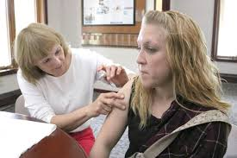
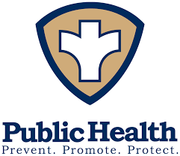
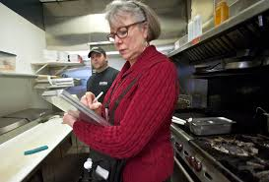
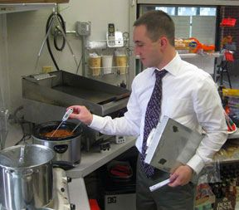
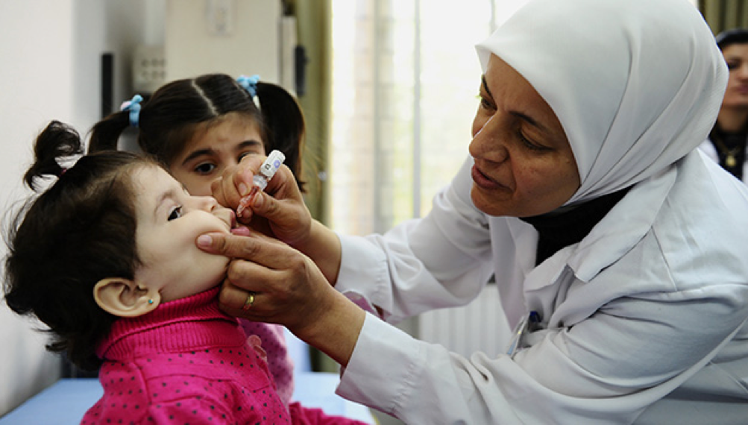
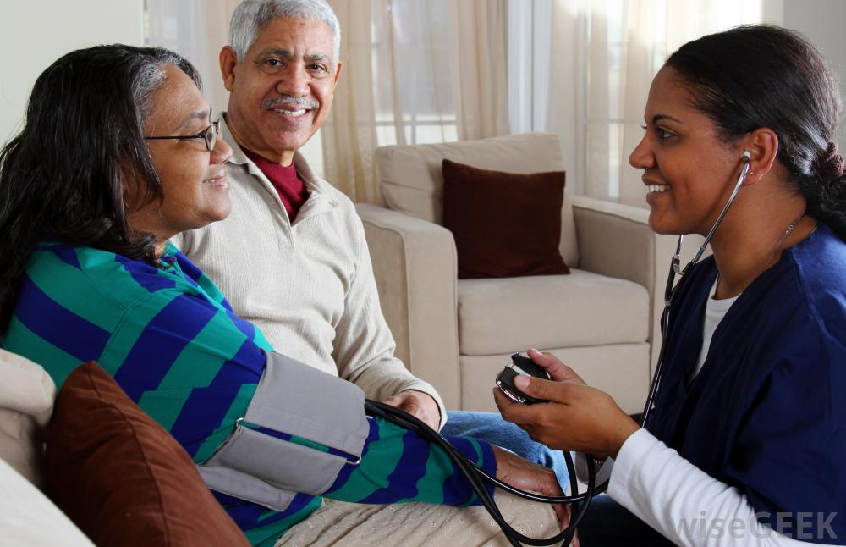
Public Health: History & Challenges
Massachusetts Association of Health Boards (MAHB)
November 2018
Laura Kittross, Public Health Program Manager
Berkshire Regional Planning Commission

Slide 2
Outline & Learning Objectives
What is Public Health?
What is the history of public health and how have the needs changed over time?
What are some of the challenges for local boards of health in Massachusetts in meeting their mandated services?
What are the social determinants of health and how do they affect population health in Massachusetts?

Slide 3
What is Public Health?
Public health is defined as the science of protecting the safety and improving the health of communities through education, policy making and research for disease and injury prevention.
Community Health: Public health is concerned with the health of the community as a whole; public health is community health.
Wellness: The primary mission of public health is to support community wellness and to prevent hazards and illness from spreading through the community.
Prevention: The purpose of public health is to prevent disease.

Slide 4
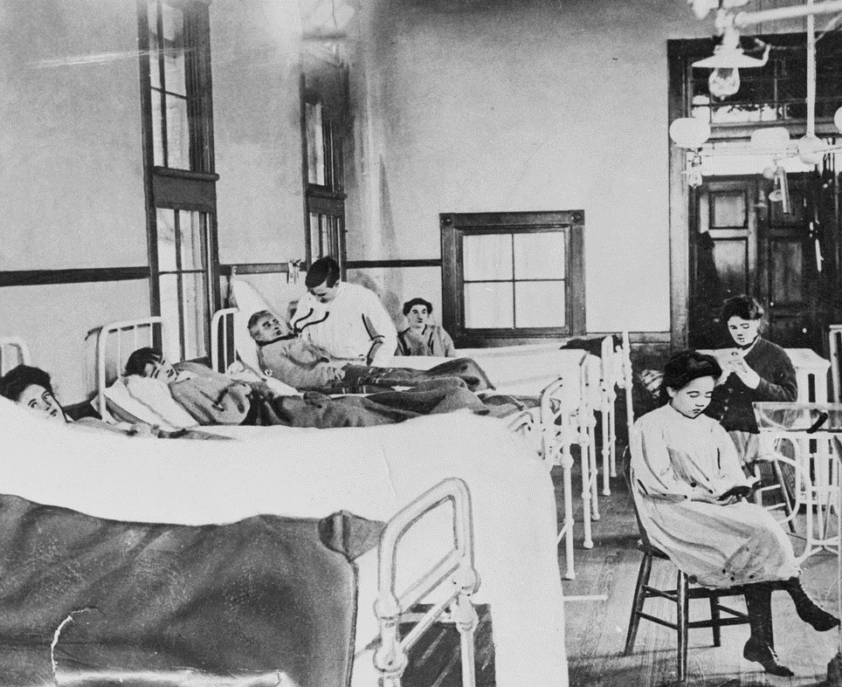
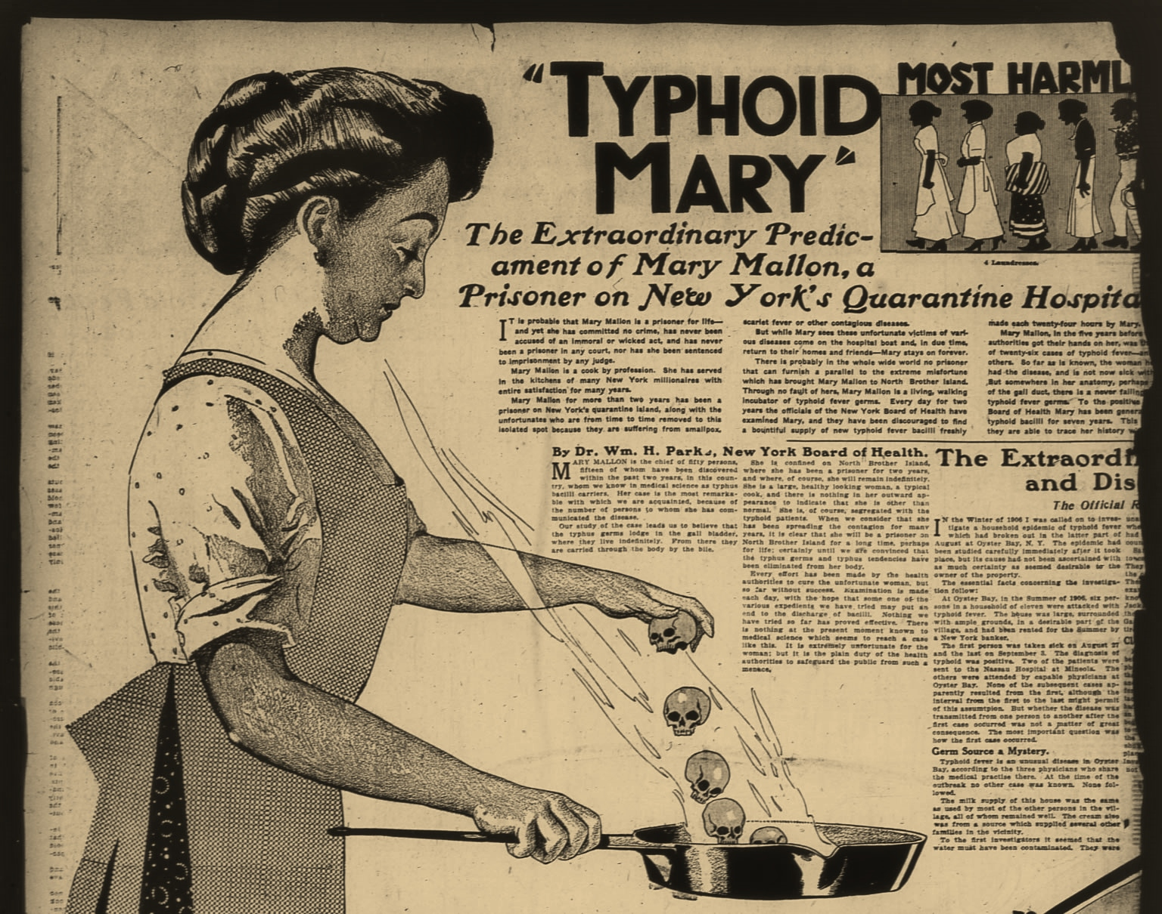
History of Public Health: Early Isolation & Quarantine Rules
The earliest public health measures were directed toward isolation of the ill & quarantine of travelers as epidemics like the plague, cholera and smallpox swept through Europe in the 18th century.
In 1701 Massachusetts passed laws for isolation of smallpox patients and for ship quarantine as needed.
By the end of the eighteenth century, several cities, including Boston, Philadelphia, New York, and Baltimore, had established permanent councils to enforce quarantine and isolation rules and had begun to establish voluntary general and mental hospitals, acknowledging some societal responsibility toward those who were ill.

Slide 5
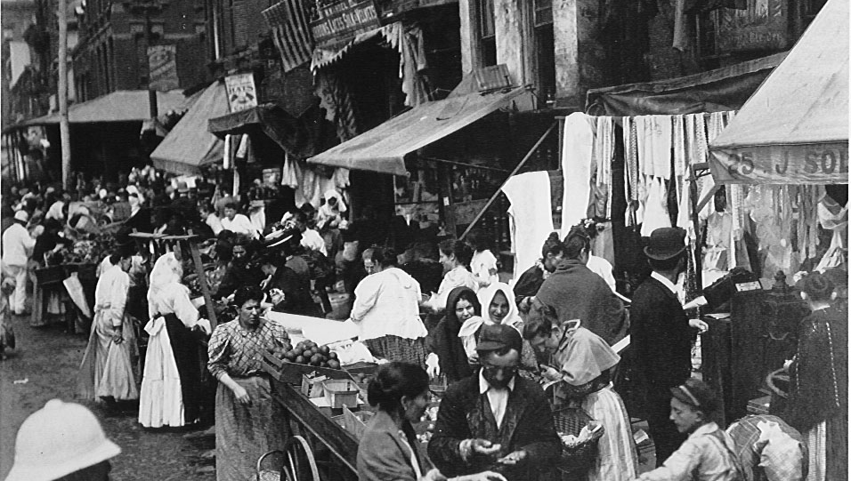
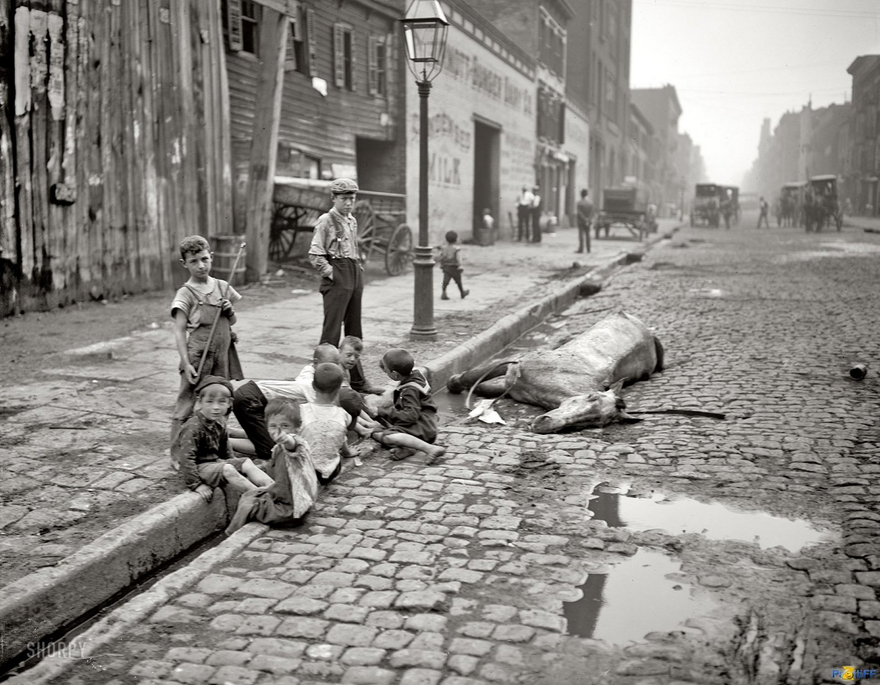
The Great Sanitary Awakening: 19th Century
With increasing urbanization, filthy conditions became common in the cities and infectious disease ran rampant. In London, more than ½ the working class population died before their 5th birthday, and tuberculosis, cholera, smallpox and typhoid were common.
In New York, as late as 1865, "the filth and garbage accumulate in the streets to the depth sometimes of two or three feet." In a 2-week survey, inspectors found more than 1,200 cases of smallpox and more than 2,000 cases of typhus in one ward. (Winslow, 1923)
In Massachusetts in 1850, deaths from tuberculosis were 300 per 100,000 population, and infant mortality was about 200 per 1,000 live births. (Hanlon and Pickett, 1984)
Even the wealthy could not protect themselves from infectious disease – most families lost children to diphtheria, smallpox, or other infectious diseases.
Increasingly public health was seen as a societal issue.

Slide 6
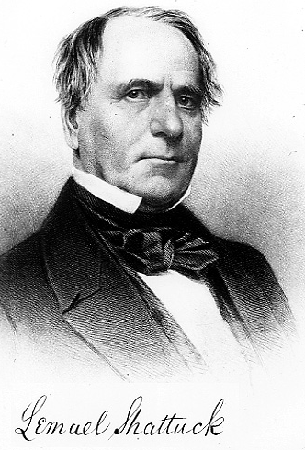
1850: Report of the Massachusetts Sanitary Commission
Lemuel Shattuck, a Massachusetts bookseller and statistician, collected vital statistics on the Massachusetts population, documenting differences in morbidity and mortality rates in different localities. Shattuck showed that the poor living conditions in the city threatened the entire community. "Even those persons who attempted to maintain clean and decent homes were foiled in their efforts to resist diseases if the behavior of others invited the visitation of epidemics."

Slide 7
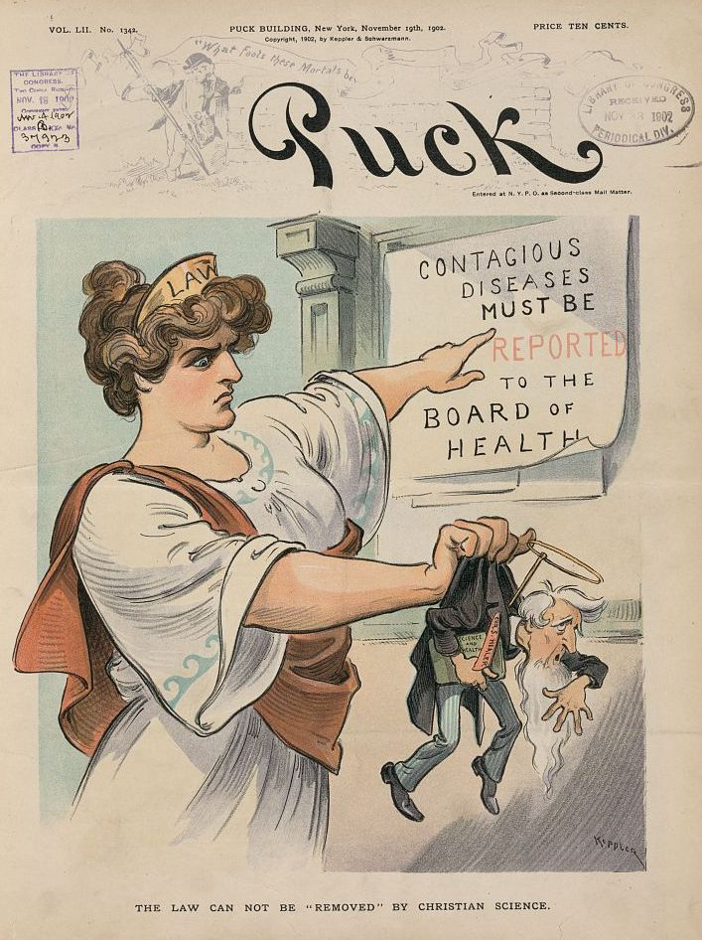
State Board of Health
Shattuck’s report recommended, among other things, new census schedules; regular surveys of local health conditions; supervision of water supplies and waste disposal; special studies on specific diseases, including tuberculosis and alcoholism; education of health providers in preventive medicine; local sanitary associations for collecting and distributing information; and the establishment of a state board of health and local boards of health to enforce sanitary regulations.
Massachusetts set up a state board of health in 1869.
By 1900, 40 of 45 states had set up health depts.

Slide 8
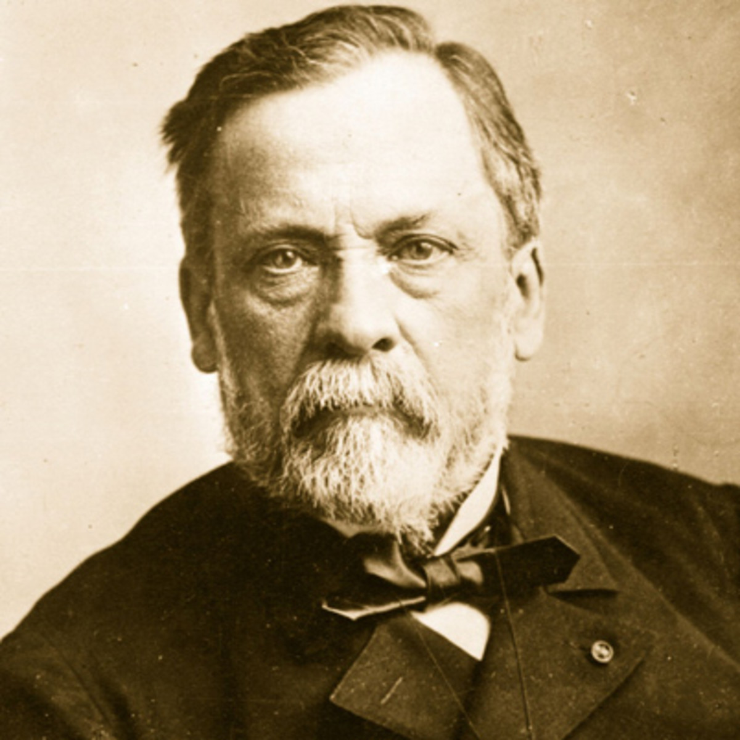
Age of Bacteriology: Late 19th Century
Louis Pasteur, a French chemist, proved in 1877 that anthrax is caused by bacteria. In the following few years, bacteriologic agents were identified for such contagious diseases as tuberculosis, diphtheria, typhoid, and yellow fever.
The identification of bacteria and the development of interventions such as immunization and water purification techniques provided a means of controlling the spread and the prevention of disease. For the first time, it was known that diseases had single, specific causes, and that both the environment and people could be the agents.
Public agencies developed to conduct and enforce sanitary measures expanded into laboratory science and epidemiology. One of the first public health laboratories was established in MA in 1890’s.

Slide 9
Early 20th Century Public Health Successes
After water filtering systems were put in place around 1908, typhoid rates were cut in half or better in many American cities.
Deaths from yellow fever in Havana dropped from 305 to 6 in one year after mosquitoes were identified as carriers of the yellow fever virus.
Health departments expanded into clinical care and health education. In the early twentieth century, the NY and Baltimore health departments began offering home visits by public health nurses. New York established a campaign for education on tuberculosis. School health clinics were set up starting in Boston in 1894. Local health agencies set up clinics to deal with tuberculosis and infant mortality; by 1915, there were more than 500 tuberculosis clinics and 538 baby clinics in America, predominantly run by city health departments.

Slide 10
Mid 20th Century
From the 1930s through the 1950s, state and local health departments made substantial progress in disease prevention activities, including sewage disposal, water treatment, food safety, organized solid waste disposal, animal & pest control, and public education about hygienic practices (e.g., foodhandling and handwashing).
Chlorination and other treatments of drinking water began in the early 1900s further decreasing the incidence of waterborne diseases.
The incidence of TB continued to decline due to improved housing and other TB control activities.
Malaria, once endemic throughout the southeastern United States, was reduced to negligible levels by the late 1940s through regional mosquito-control programs.
The U.S. Marine Hospital Service (later the Public Health Service) led quarantine and ship inspection activities and rodent and vector-control operations leading to the last major rat-associated outbreak of plague in the US in 1924-1925 in Los Angeles..
Strategic vaccination campaigns virtually eliminated diseases previously common in the United States, including diphtheria, tetanus, poliomyelitis, smallpox, measles, mumps, rubella, and Haemophilus influenzae type b meningitis.
Penicillin, which became widely available in the 1940s, continued to decreased death and morbidity from infectious diseases.

Slide 12
CDC’s Ten Greatest Public Health Successes of the 20th Century
1. Vaccination
2. Motor-vehicle safety
3. Safer workplaces
4. Control of infectious diseases
5. Decline in deaths from coronary heart disease and stroke
6. Safer and healthier foods
7. Healthier mothers and babies
8. Family planning
9. Fluoridation of drinking water
10. Recognition of tobacco use as a health hazard
Average lifespan increased by 25-30 years over the 20th century

Slide 13
SO WHAT’S LEFT FOR PUBLIC HEALTH TO DO IN 2018?

Slide 14
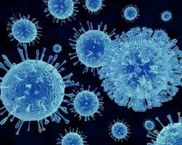
Food Protection
CDC estimates that each year roughly 1 in 6 Americans (48 million people) gets sick, 128,000 are hospitalized, and 3,000 die of foodborne diseases. Some estimates are even higher.
The U.S. Department of Agriculture (USDA) estimates that foodborne illnesses cost $15.6 billion each year.
About a third of all meals are eaten outside of the home and almost 1/2 of all consumer food expenditures go toward food made in the retail setting (restaurants, delis, etc.).
53% of known sources of foodborne illness occur from food produced in the retail setting.

Slide 15
MA Local Board of Health Actions
Restaurants, institutional kitchens (schools, camps, nursing homes, etc.) and retail stores that sell food are licensed and inspected every 6 months by the local Board of Health, with further follow-up, as needed. BOH also confirm that food workers are properly trained in food safety.
Temporary food events, such as street fairs or church suppers, that do not take place in a licensed kitchen, are licensed & inspected by the BOH.
Processed food at farmer’s markets, caterers, mobile food vendors, and seasonal frozen dessert vendors.
Foodborne illness reports are investigated and if a food establishment is implicated, it is inspected.
Inspections in response to complaints about cleanliness or illness.
Food safety if an emergency shelter is set up.

Slide 16
Challenges
Many MA health departments lack sufficient personnel to conduct required inspections, and follow up on complaints.
Only ServeSafe (or similar) is required training for food inspectors; while this provides basic training in food safety, it contains NO content related to performing inspections. DPH does recommend further training, but there is no oversight and training is not readily available.
Inspectors are discouraged from requiring strict compliance from restaurants important to their municipality’s economy, from street fairs or other festivals that are important to civic pride or from non-profits, such as churches or firefighter cookouts.

Slide 17
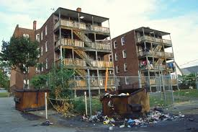
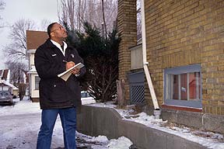
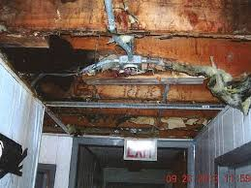
Housing
Poor housing conditions are associated with a wide range of health conditions, including respiratory infections, asthma, lead poisoning, communicable diseases, injuries, and mental health conditions.
Children living in poor or overcrowded conditions are more likely to have respiratory problems, to be at risk of infections, be exposed to lead paint or asbestos, and have mental health problems. Growing up in poor housing has a long-term impact on a child's learning and education.
In 2012, the cost of potentially preventable hospitalizations for pediatric asthma was $417 million (H-CUP). Rates per 100,000 are twice as high for lowest income children.
Annually home injuries result in an 4 million emergency dept. visits & 70,000 hospital admissions (RWJF).
Preventing lead exposure among children can improve intelligence and behavior, resulting in increased earning potential and lower health care costs; est. economic benefits ranging from $110 to $319 billion dollars annually (RWJF).

Slide 18
Local Board of Health Actions
Local Boards of Health inspect housing upon complaint, upon referral from first responders/social service agencies, due to obvious poor conditions visible from the street or periodically (e.g., pre-rental programs in some municipalities).
In addition to poor conditions/complaints, the BOH will be involved in situations involving hoarders or fires/structural damage.
A comprehensive inspection includes bathroom facilities, kitchen facilities, water supply, hot water facilities, heating facilities, lighting and electrical facilities, metering, installation and maintenance of facilities, asbestos, smoke/CO detectors, exits, maintenance of structural elements, pests, including insects, rodents & skunks, garbage and rubbish removal and storage, security and lead paint.
Housing cases often involve multiple orders, negotiations with landlords and owners, BOH hearings, condemnations, orders to vacate and housing court. Complaints generally must be responded to within 24 hours.
BOHs also inspect hotels and motels, dormitories and farm labor camps under the Housing Code.
BOH also investigate “nuisance complaints” which encompass noise, construction debris, air quality, overgrown grass/shrubs, trash, etc.

Slide 19
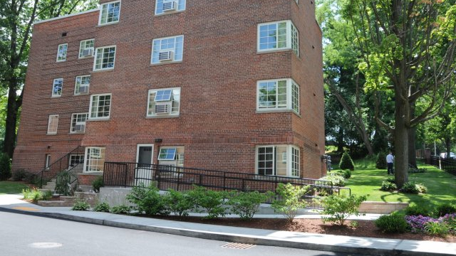
Challenges
Lack of sufficient personnel to adequately investigate all housing complaints.
No training requirements for housing inspectors. Most have received little to no training.
Tenants and landlords can be difficult to deal with; conditions are often unsanitary and dangerous.
Many inspectors are intimidated by court action, and receive little or no help from town counsel.
Difficult decisions must be made regarding people’s lives, with little support from social services.

Slide 20
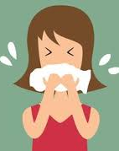
Infectious Disease Surveillance, Investigation and Follow-up
Infectious disease remains a threat to all MA residents – disease does not stop at the town border.
In 2015, 192 cases of tuberculosis in Massachusetts (2.8 per 100,000). 30 of these cases were resistant to one or more drugs.
MA currently sees more than 9,000 new Hepatitis C cases per year.
In 2014, some 5,600 MA residents were either confirmed or probable positives for Lyme disease; other tickborne illnesses are also increasing.
Occasional outbreaks of vaccine preventable diseases continue: mumps, measles, pertussis (whooping cough), Hepatitis B.
9 million to 35 million Americans still get the flu each winter, with up to 140,000 - 710,000 hospitalized and 12,000 - 56,000 deaths.
Emerging diseases such as Zika and Ebola create additional work.
Since 1985, more than 5,000 animals have tested positive for rabies in MA, including pets and farm animals.

Slide 21
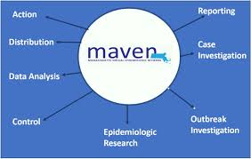
Local Board of Health Actions
More than 90 diseases are directly reportable to the LBOH in Massachusetts.
Each BOH must check the Massachusetts Virtual Epidemiologic Network (MAVEN) daily for reports.
Most reportable diseases require telephone call follow-up with healthcare providers and/or the patient.
If an outbreak is suspected or possible, local BOH, with DPH, must provide appropriate prophylaxis to the public (Hepatitis A in a food handler, vaccine preventable disease outbreak).
The LBOH is responsible for following up on all suspected TB cases, and for providing or overseeing medication administration to active cases for 6-9 months.
Many LBOH sponsor public flu vaccination clinics leading to higher vaccination rates in their communities.
Working with the Animal Control Officer, BOH must help manage rabies exposure in their municipality.
LBOH are responsible to enforce any isolation or quarantine orders in their municipality (e.g., Ebola in 2014).

Slide 22
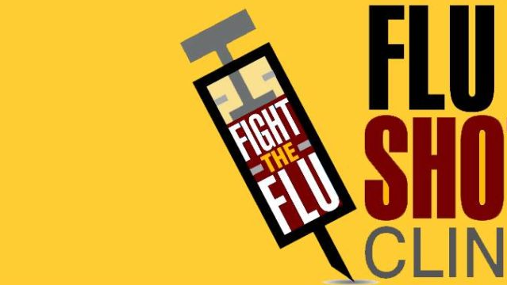
Challenges
Relatively few BOH still have Public Health Nurses on staff; many contract out or have a non-medical staff person monitor MAVEN. BOH w/out PHN on staff lose public health nursing assistance and collaboration with inspectional staff, e.g., in a housing case or foodborne illness investigation.
Few BOH personnel are medically or epidemiologically trained.
While training on MAVEN is required there are no other workforce training or education requirements.
Localized system means it is difficult to get a full picture of what is happening with infectious disease on a regional level (DPH monitors at a state and larger regional area).
MAVEN is difficult to use if not used regularly.
Flu vaccine is expensive; while BOH can bill insurance this is time-consuming, and vaccine must be purchased in advance.
Although TB cases are rare in many communities, the time and expense can be overwhelming when it happens.

Slide 23
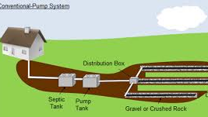
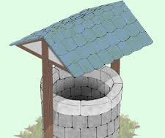
Environmental Protection
Improperly treated wastewater from residences or businesses can cause disease, and contaminate both ground and surface water.
Approximately 1/3 of homes in MA do not have access to municipal sewer, and have their own septic systems. Spread across the state, although more prevalent in rural areas.
A failed septic system can involve thousands of dollars in repair. New systems can cost $20,000 - $50,000, and a failed system can delay a sale or transfer of property. There are currently no licensing or educational requirements for septic system installers in MA (engineer must design >2000 gallons).
Private wells can become contaminated with hazardous or toxic substances, or with septage, if not properly maintained or sited. Abandoned wells can become a hazard if not properly decommissioned.

Slide 24
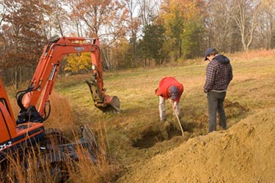
Local Board of Health Actions
As the local arm of the Department of Environmental Protection (DEP) LBOH regulate onsite individual and group septic systems through enforcement of Title 5. Title 5 regulates the proper siting, construction, upgrade, and maintenance of on-site sewage disposal systems and appropriate means for the transport and disposal of septage.
The LBOH must review the Title 5 inspection report prior to the sale or transfer of property. Many BOH witness the inspection to ensure the report is accurate.
The LBOH also witnesses and reviews results from “perc” (percolation) tests to determine the proper siting of a new system, reviews and approves design plans for a new or rebuilt system prior to construction, and inspects the system during construction to ensure it is built in compliance with approved plans.
LBOH also regulate new wells and the decommission of old wells.
Investigate other environmental contamination issues, such as industrial discharges

Slide 25
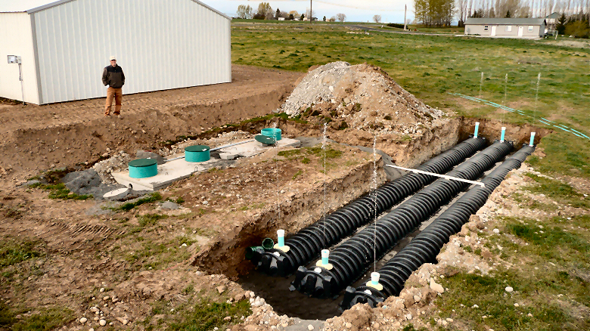
Challenges
Inspector must have the ability to read engineer’s plans, understand how a septic system works, and understand soils and water tables.
While training is only required when recommending approval of a variance, most inspectors should have expensive training (soil evaluator, Title 5 inspector) that is not readily available and requires extensive continuing education credits to keep current.
BOH without trained, knowledgeable personnel on staff risk approving expensive systems that fail within a few years.

Slide 26
And that’s not all … other responsibilities of the Local BOH in MA
Recreational Camps for Children
Including buildings, emergency procedures, health procedures, vaccination records, background checks for staff, food preparation, waterfront and pool safety, and much more. Must be inspected each session.
Emergency Preparedness Planning
Including Emergency Dispensing Sites (EDS), hazmat, radiation, sheltering, public information/risk communication.
Hazardous, Medical and Biological Waste
Solid Waste & Recycling
Public and Semi-public Bathing Beaches
Including weekly testing in season, closure when necessary
Indoor Ice Skating Rinks
Mobile Home Parks
Family Campgrounds
Tobacco Control
Including licensing of vendors, investigating complaints, local regulations
Air Quality Complaints
Public & Semi-Public Swimming Pools & Hot Tubs
Inspections twice yearly, including appropriate use of chemicals for sanitation, safety of equipment and facility, safety procedures.
Body Art/Tattoo parlors and practitioners
Tanning Facilities
Beaver control
Other Animals & Vectors
including mosquito control and education about tickborne illness
Septage and Garbage Haulers
Other, miscellaneous
including pesticides, funeral director licensing, burial permits, kennels, animal inspector, etc.

Slide 27
Changes in Mortality
Today chronic disease is implicated in more than 80% of deaths, up from 20% in 1900.
In 1900, 1/3 of deaths came from TB (11%), pneumonia and flu (12%), diphtheria (2%) and diarrheal diseases (8%). 40% of these deaths were in children under age 5.
Only influenza and pneumonia (3%) remains a leading cause of death in 2010.
In 1900, over 30% of all deaths were in children under age 5; by 1997 only 1.4% of deaths were.

Slide 28
Chronic Disease Costs (Data from CDC)
As of 2012, about half of all adults—117 million people—had one or more chronic health conditions. One in four adults had two or more chronic health conditions.
Eighty-six percent of the nation’s $2.7 trillion annual health care expenditures are for people with chronic physical and mental health conditions.
Total annual cardiovascular disease costs to the nation averaged $316.1 billion in 2012–2013. Of this amount, $189.7 billion was for direct medical expenses and $126.4 billion was for lost productivity costs (from premature death).
Cancer care cost $157 billion in 2010 dollars.
The total estimated cost of diagnosed diabetes in 2012 was $245 billion, including $176 billion in direct medical costs and $69 billion in decreased productivity. Decreased productivity includes costs associated with people being absent from work, being less productive while at work, or not being able to work at all because of diabetes.
The total cost of arthritis and related conditions was about $128 billion in 2003. Of this amount, nearly $81 billion was for direct medical costs and $47 billion was for indirect costs associated with lost earnings.
Medical costs linked to obesity were estimated to be $147 billion in 2008. Annual medical costs for people who were obese were $1,429 higher than those for people of normal weight in 2006.
For the years 2009–2012, economic cost due to smoking is estimated to be at least $300 billion a year. This cost includes nearly $170 billion in direct medical care for adults and more than $156 billion for lost productivity from premature death estimated from 2005 through 2009.

Slide 29
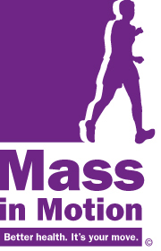
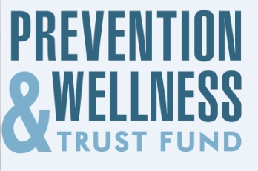
Wellness & Prevention
In 2006, hospital costs for potentially preventable conditions totaled nearly $30.8 billion. As many as 4.4 million hospital stays might have been prevented with better ambulatory care, improved access to effective treatment, or patient adoption of healthy behaviors. In 2017, MA ranked 35th on this measure (America’s Health Rankings) for Medicare patients.
Chronic disease costs can be reduced. Examples in MA include Prevention Wellness Trust Fund, Mass in Motion, Workplace Smoking Laws.
On a national level, County Health Rankings from Robert Wood Johnson Foundation take into account health behaviors and environmental conditions in determining the healthiest states and counties.

Slide 31
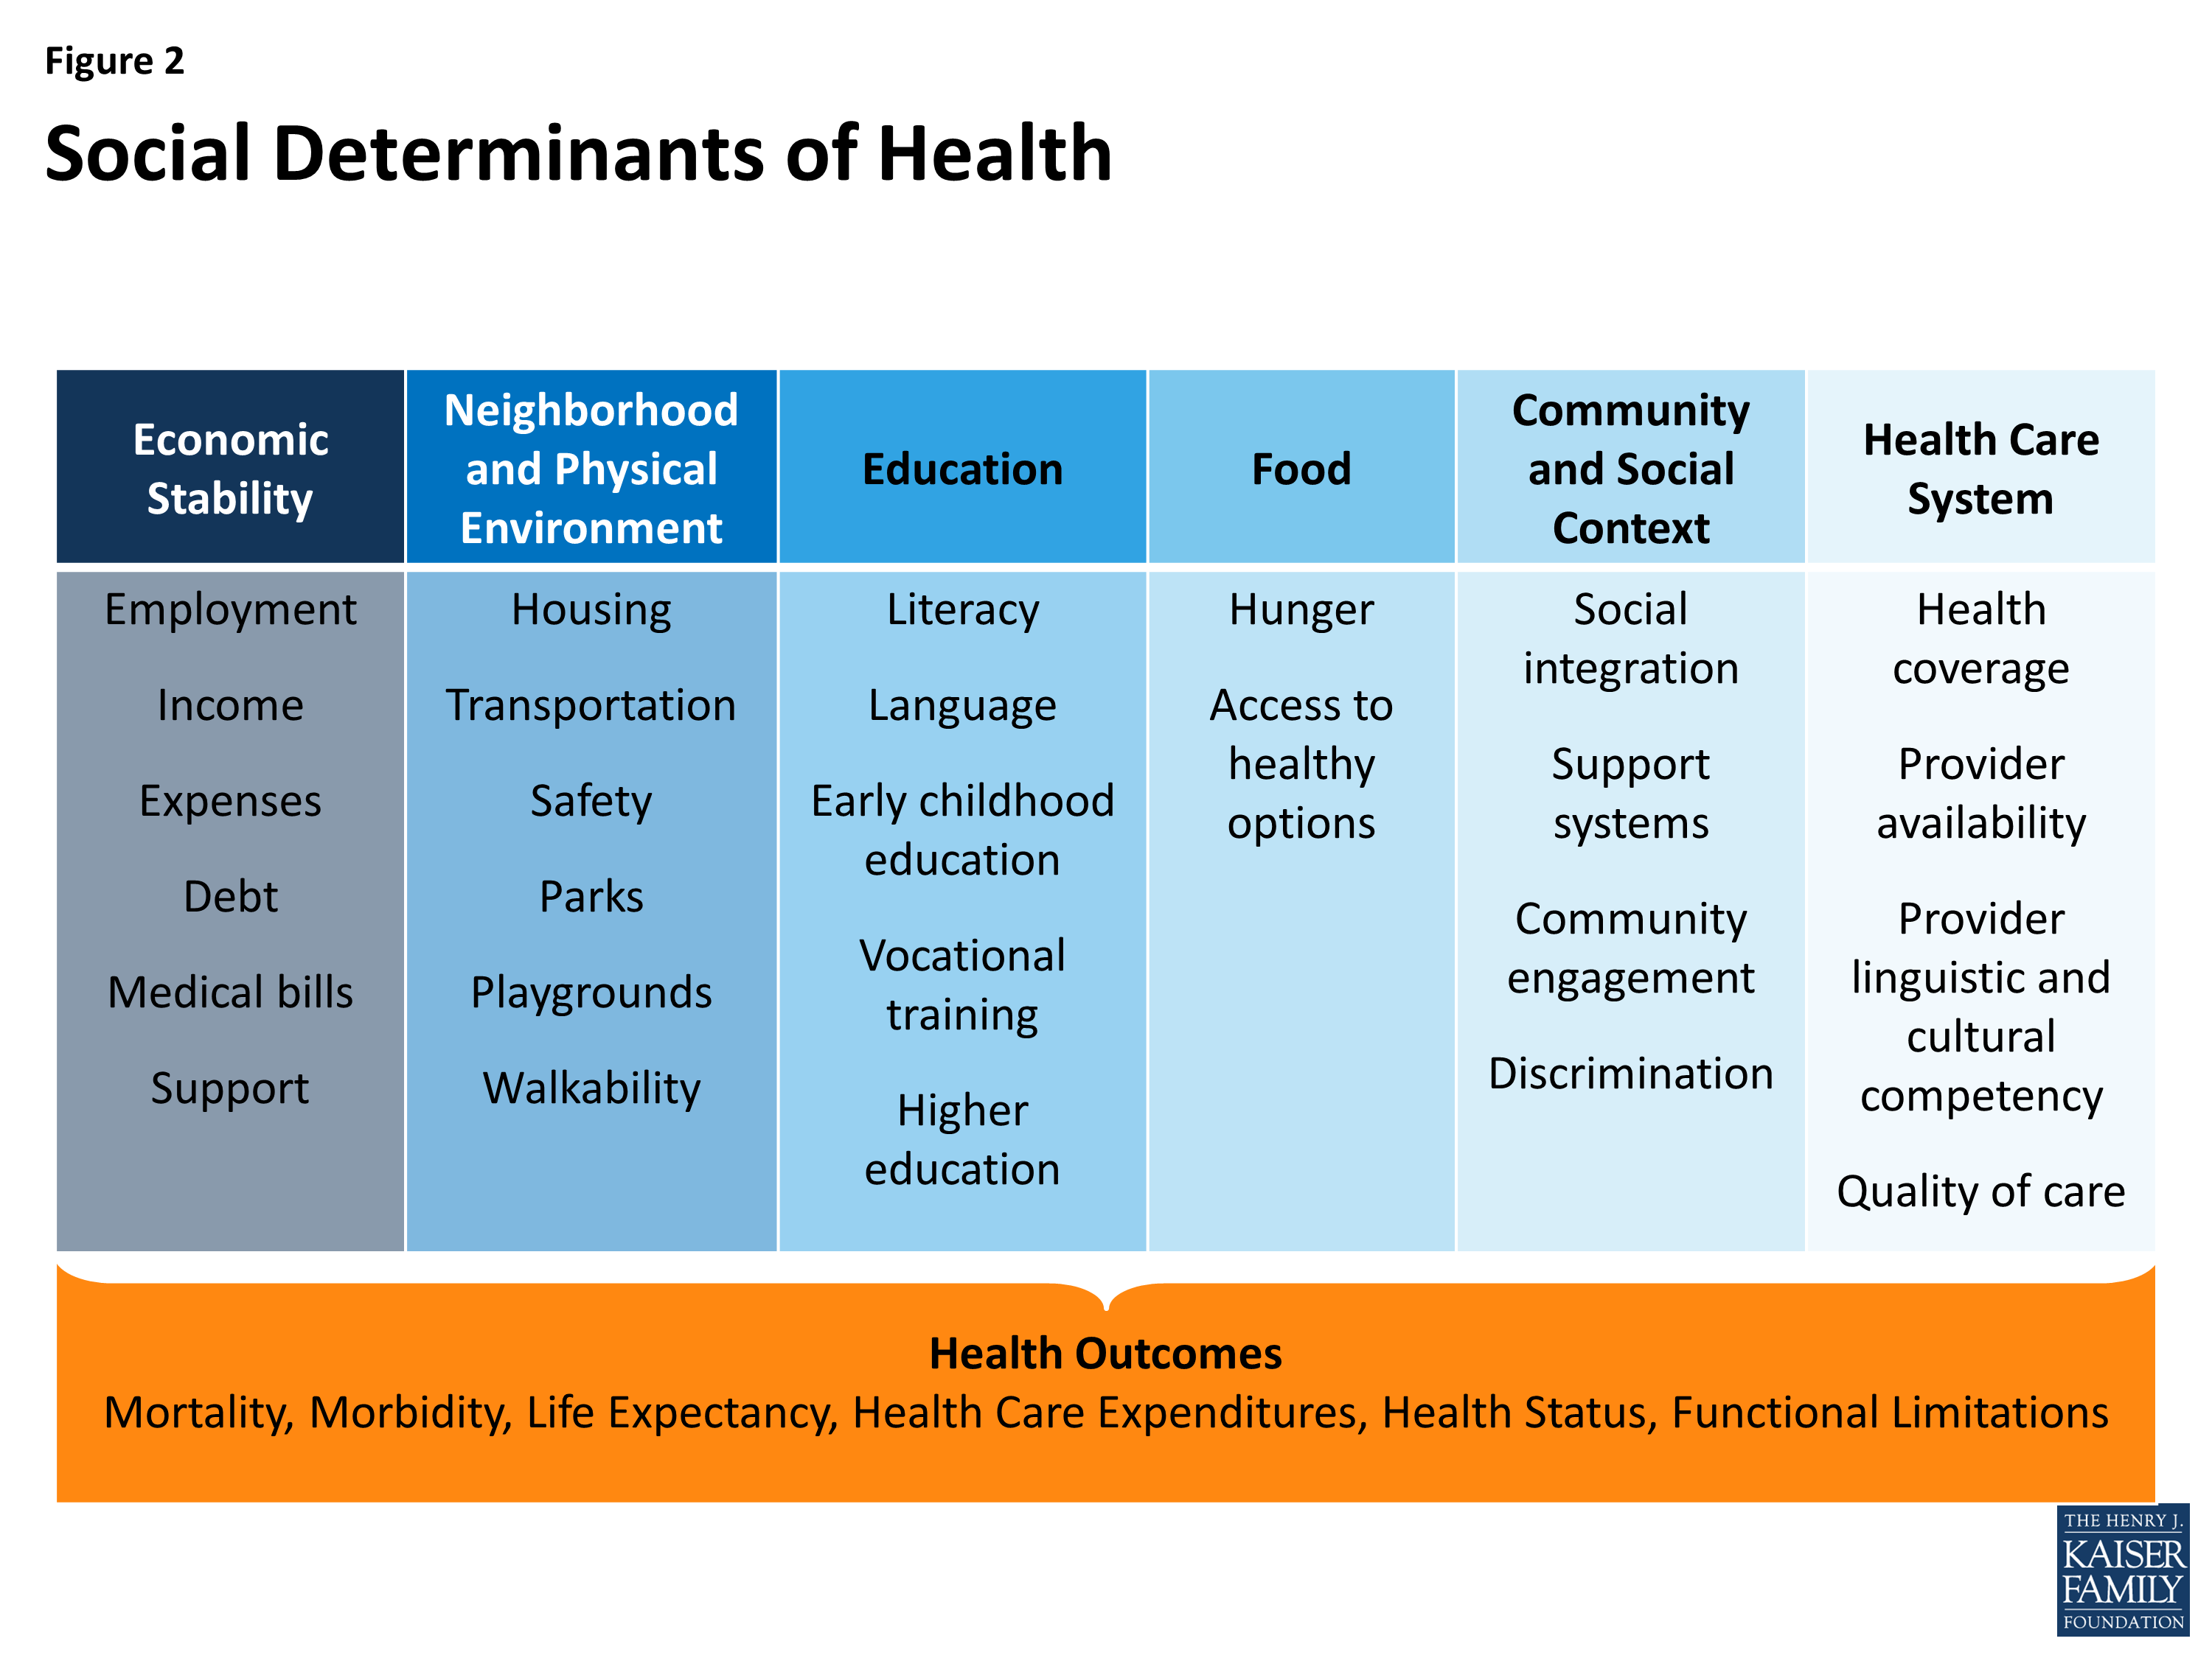
Social Determinants of Health
Social determinants of health are “the structural determinants and conditions in which people are born, grow, live, work and age.” They include factors like socioeconomic status, education, the physical environment, employment, and social support networks, as well as access to health care

Slide 32
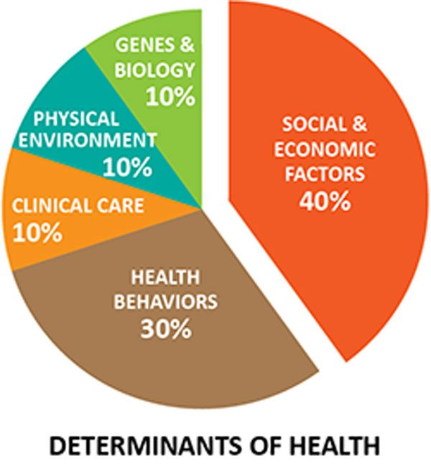

Slide 34
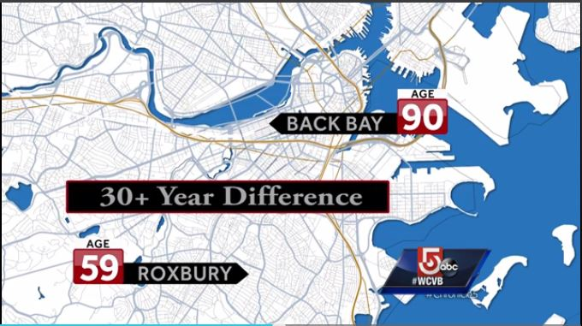

Slide 35
Biggest Overall Challenges for Local Public Health
Funding is at the local municipality’s discretion, meaning LBOH are perennially underfunded and health disparities and inequities are created between municipalities.
No required workforce training or credentials means public health work is often undervalued, leading to underfunding compared to other municipal departments.
No required training or credentials means in some communities unqualified personnel – including elected BOH members – are conducting BOH work, including inspections.
Transition to inspectional services model separates environmental responsibilities from epidemiology and infectious and chronic disease control, undermining prevention efforts.
Multiple and varied responsibilities make it difficult to be fully qualified and knowledgeable in all areas. Every year BOH are expected to do more, with no additional funding or training.

Slide 36
Biggest Overall Challenges for Local Public Health
Many board of health staff are retiring or about to retire, with few workers in the pipeline.
Little oversight to determine if LBOH are meeting their mandated services.
Climate change, leading to increased flooding and other environmental issues and emergencies, as well as emerging diseases (e.g., increasing tickborne illness across the state).
No time to concentrate on chronic disease or wellness. Moving the needle on Social Determinants of Health.
Lack of understanding about what public health does/what its value is. If public health is doing its job right, no one notices it.

Slide 37
